Slide 1
UNITED WAY AND YOU—
WHERE IT ALL COMES TOGETHER
A THRIVING COMMUNITY FOR ALL
hwmuw.org

Slide 2
REAL WORK, REAL IMPACT
FOCUSING ON THE BIGGEST ISSUES
IN OUR COMMUNITY

Slide 3

WE FIGHT FOR ALICE
It’s no secret that people experiencing poverty struggle to meet their basic needs. But so do many families with incomes above the federal poverty level.
We call these households ALICE:
Asset-Limited
Income-Constrained
Employed
1 out of 4 households is ALICE.
33%
Households living below the federal poverty line combined with ALICE.

Slide 4
ALICE IN KENT COUNTY
33% of households in Kent County struggle to make ends meet

Slide 5
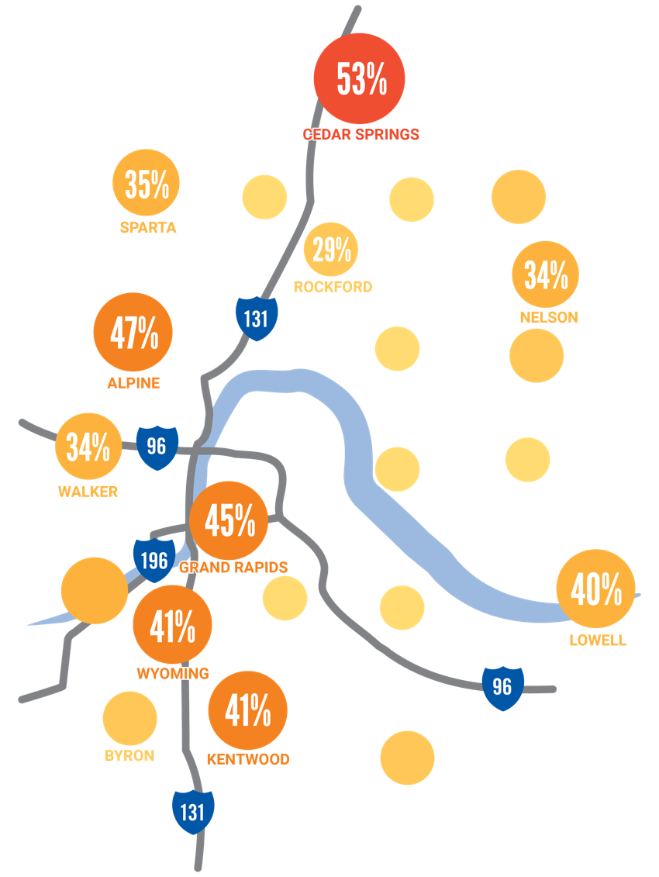
ALICE IN KENT COUNTY
ALICE exists in all parts of the county.
Notes:
19 is about 1 in 5

Slide 6
HOUSEHOLD SURVIVAL BUDGET
 | Hourly Wage | Annual Total
Single Adult | $14.29 | $28,584
Two Adults | $20.69 | $41,376
One Adult + one in childcare | $20.44 | $40,884
Two Adults + two in childcare | $32.11 | $64,212
Single senior | $16.12 | $32,232
Two Seniors | $25.01 | $50,028
Survival budget includes:
Housing, utilities, childcare, food, transportation, health care, technology, tax payments & credits, and a little for miscellaneous items.

Slide 7
DISPARITIES IN KENT COUNTY
Households of all ages, genders, races, and ethnicities—but certain groups are more likely to be ALICE.
BLACK
HISPANIC
ASIAN
SENIORS
SINGLE FEMALE HEAD OF HOUSEHOLD

Slide 8
ALICE IN MICHIGAN
39% of households in Michigan struggle to make ends meet

Slide 9
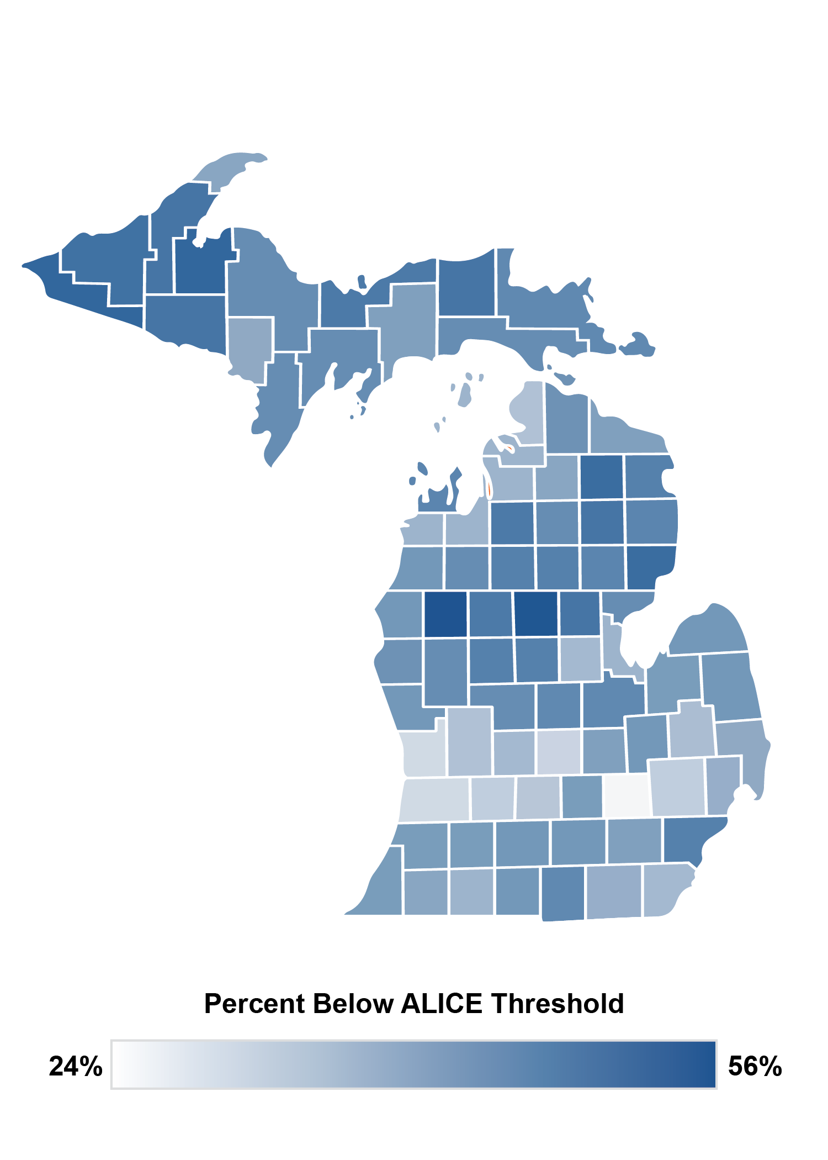
ALICE IN MICHIGAN

Slide 10
HOUSEHOLD SURVIVAL BUDGET
 | Hourly Wage | Annual Total
Single Adult | $12.97 | $25,932
Two Adults | $19.25 | $38,508
One Adult + one in childcare | $18.53 | $35,412
Two Adults + two in childcare | $29.51 | $59,016
Single senior | $14.74 | $29,472
Two Seniors | $23.45 | $46,908
Survival budget includes:
Housing, utilities, childcare, food, transportation, health care, technology, tax payments & credits, and a little for miscellaneous items.

Slide 11
DISPARITIES ACROSS THE STATE
BLACK
HISPANIC
UNDER 25
YEARS OLD
SINGLE FEMALE HEADED WITH CHILDREN
ALL HOUSEHOLDS

Slide 12
INVESTING IN LONG-TERM SOLUTIONS
A THRIVING COMMUNITY FOR ALL

Slide 13
IT TAKES US ALL
“There are so many causes, and your dollars could go further at United Way. One organization cannot address all the needs our community faces. United Way is able to provide a solution to a complex need.”
–Emily

Slide 14



INVESTING IN LONG-TERM SOLUTIONS
We partner with 50+ nonprofits through our
Community Grant Fund to:
Remove barriers
Provide wraparound services
Fight the root causes
of poverty
FAMILY STABILITY
EDUCATION
ECONOMIC MOBILITY

Slide 15

FAMILY STABILITY
Stable, affordable, and safe housing
Affordable and nutritiously diverse food
Quality mental/behavioral
health services
Family support services

Slide 16
FAMILY STABILITY
88% of households increased understanding of how to resolve their housing crisis.
1,161,785 POUNDS of food distributed/donated.
95% of homeless or
at-risk youth received mental/behavioral health services.

Slide 17

EDUCATION
7th and 8th grade
math and science
Professional development
for providers
After-school and summer
STEM programs

Slide 18
EDUCATION
93% of students improved grades in STEM subjects.
31 teachers and after-school providers received STEM training to provide quality science and math education.
7,699 students served through funded youth education programs.

Slide 19

ECONOMIC MOBILITY
Job skills, training,
and placement
Internships and apprenticeships
Workplace language skills
Tax prep

Slide 20

ECONOMIC MOBILITY
87% of individuals improved their economic stability.
$5,005,471 returned to our community through Kent County Tax Credit Coalition’s tax prep services.
6,925 people served through funded economic mobility programs.

Slide 21
MEETING IMMEDIATE NEEDS
UNITED WAY INTERNAL PROGRAMS

Slide 22

2-1-1 CALL CENTER
Free, 24/7 helpline
Michigan 2-1-1 connects people with information and resources for things like Utility assistance, Housing, Food, and so much more.
96,000 total calls this
past year.

Slide 23
2-1-1: KENT COUNTY TOP 10 MET NEEDS (2022)

Slide 24
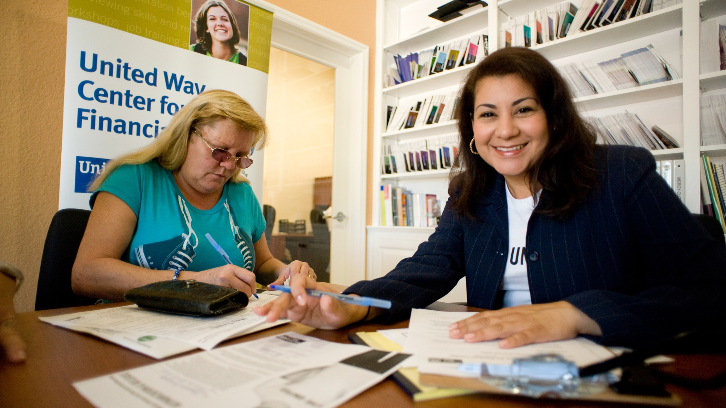
VITA PROGRAM
Volunteer Income Tax Assistance program ran by Kent County Tax Credit Coalition
Provides no-cost tax services
7,387 Returns Prepared last tax season
$5,045,044 in total refunds

Slide 25
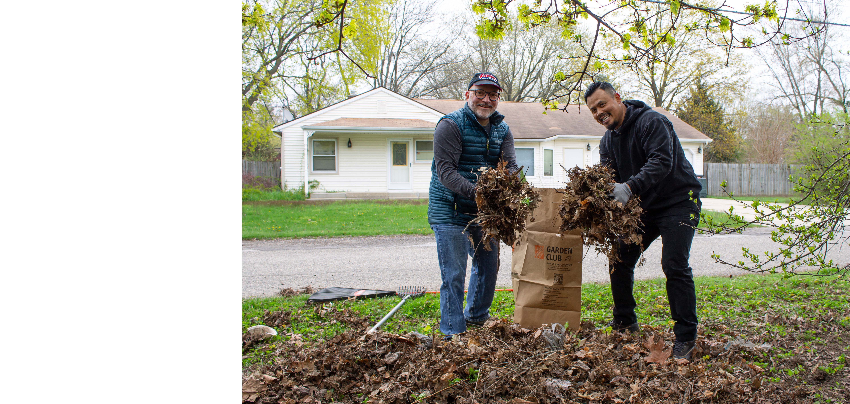
VOLUNTEER CENTER
Connects thousands of people with 300+ nonprofits in Kent County
Hosts days of service
Runs community-wide collection drives
Connects businesses with volunteer opportunities
15,000+ Volunteer hours last year

Slide 26
YOU MAKE A DIFFERENCE
CREATE CHANGE, IMPROVE LIVES

Slide 27

MEET MARIE

Slide 28





HOW DOES IT WORK?
Your donation to our Community Grant Fund combines
with others.
Volunteers review and vet grant applications to help decide where funding goes.
We award impact grants to nonprofits with services within
our three focus areas.
Funds stay here in Kent County.
Notes:
Big or small, one-time or recurring—
Grant applications happen every 3 years

Slide 29

GIVE WITH CONFIDENCE
100%
Four-star charity rating from Charity Navigator, for seven consecutive years
Scored 100 in financial and accountability/
transparency ratings from Charity Navigator
100+ years of service
in Kent County
Notes:
Charity Navigator gives a four-star rating to “exceptional” organizations who score a 90 or above in their review.
Charity Navigator shows how efficiently they believe a charity will use financial support, how well it sustains programs and services, and its commitment to good governance, best practices, and openness with information.

Slide 30
CAN WE COUNT ON YOU TO JOIN US?
HWMUW.ORG

